Slide 1



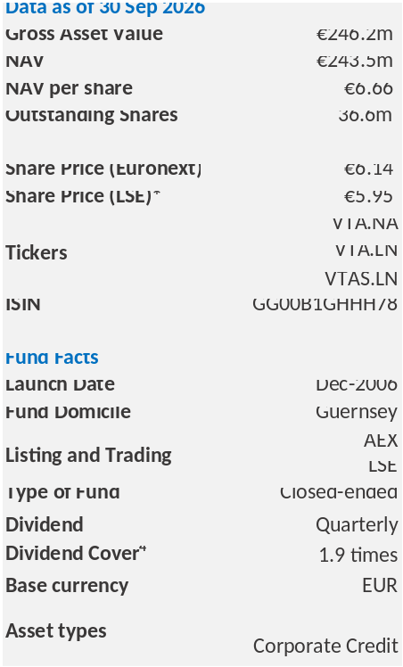

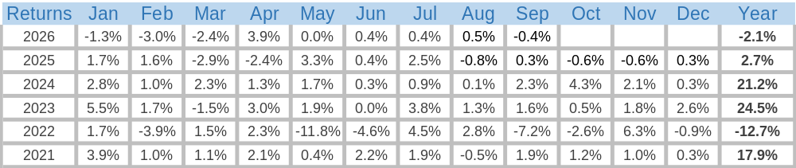
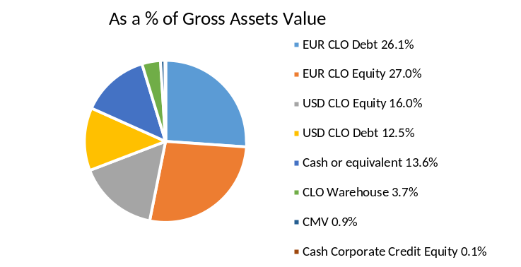
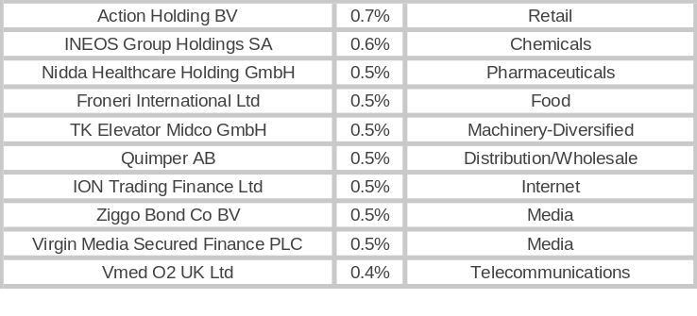
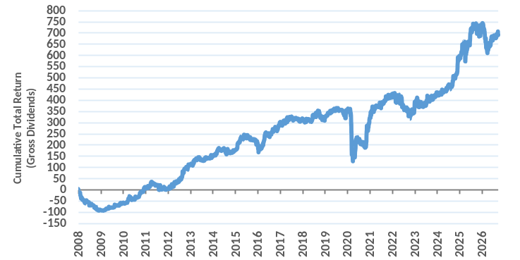
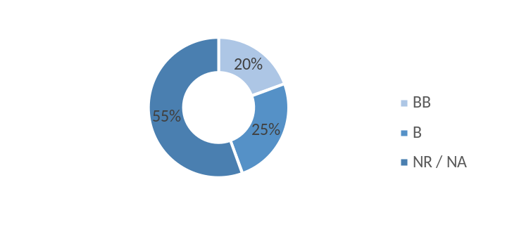
Volta Finance Ltd
L : 60 mm X 110,5 mm
Background and Investment Objective
BNP Paribas Asset Management Europe (“BNPP AM”) is the Investment Manager of Volta Finance Limited (“Volta”). Volta’s investment objectives are to preserve capital across the credit cycle and to provide a stable stream of income to its Shareholders through dividends. For this purpose, Volta pursues a multi-asset investment strategy on deals, vehicles and arrangements that provide leveraged exposure to target Underlying Assets (including corporate credit, residential and commercial mortgages, auto and student loans, credit card and lease receivables).
Fund Performance
¹ Share (VTA.NA) performance (annualised figures with dividends re-invested). Source: Bbg (TRA function) ² Performance of published NAV (including dividend payments).
³ Calculated as the most recent annual dividend payments versus the month-end share price (VTA.NA).
⁴ Calculated as total income divided by the most recent annual dividend payments.
Asset Breakdown
Top 10 Underlying Exposures
L : 97,5 mm X 55 mm
Historical Performance
Portfolio Rating Breakdown
L : 97,5 mm X 50 mm
L : 97,5 mm X 50 mm

Slide 2
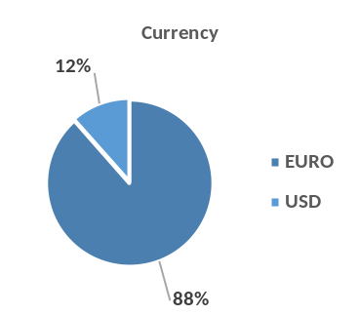
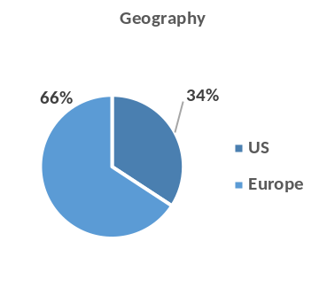
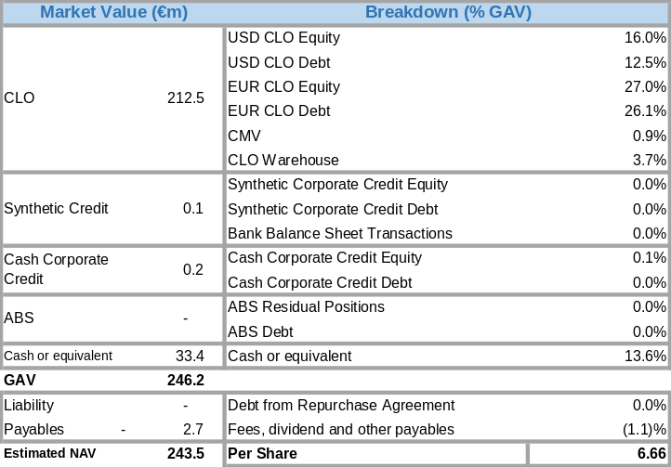
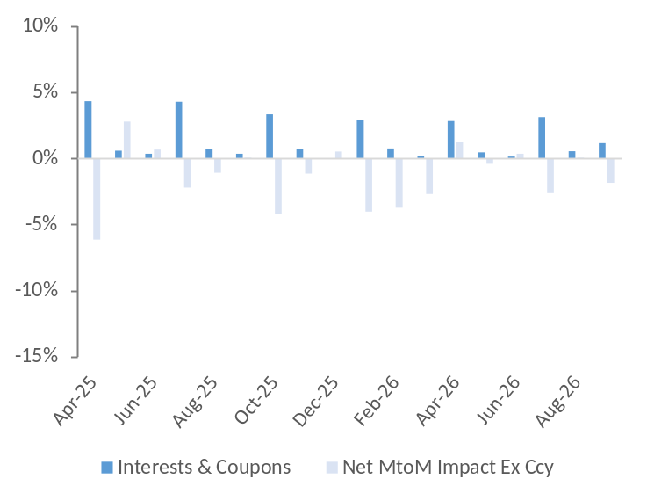
Volta Finance Ltd
Monthly Commentary
Volta Finance posted a net return of -0.4% for the month of September 2026. For comparison, both US and Euro High Yield markets were down over the same period, respectively -2.5% & -1.8% ****, while the Morningstar Leveraged Loan indices returned +0.2%*** in the US and +0.3%**** in Europe.
September was dominated by a sharp repricing of inflation and policy expectations as higher oil prices and renewed Middle East tensions pushed markets into a more volatile, headline-driven environment. Early hopes that moderating inflation might allow the Federal Reserve to remain on hold gave way to a more hawkish backdrop after stronger US inflation-related data and a renewed surge in energy prices. The ECB raised its deposit rate by 25bp and maintained a hawkish, data-dependent stance, while the Fed delivered its first-rate hike since 2023 and left the door open to further tightening. Government bond yields moved materially higher over the month, with long-dated US Treasury yields reaching multi-year highs, as investors absorbed a higher-for-longer rates outlook alongside persistent inflation risks. Although resilient growth and solid corporate earnings continued to provide some support, tighter financial conditions, elevated rate volatility and geopolitical uncertainty made for a more selective risk environment by month-end.
Against that backdrop, credit markets remained relatively orderly despite the rates shock, with spreads widening only modestly even as broader risk sentiment weakened. Credit resilience stood in contrast to the significant volatility in government bonds and equities, but the combination of higher real yields, rising funding costs and renewed inflation concerns increasingly weighed on valuations and reinforced the need for selectivity across risk assets. For structured credit, the month was therefore characterised less by fundamental credit deterioration than by the interaction between persistent macro resilience, higher energy-driven inflation risk and a more restrictive policy outlook.
.
We purchased EUR 7.3 million across three European single-B rated CLO tranches at discount margins of approximately 1,000 bps, as well as three minority CLO equity positions following the decrease in loans price. Volta is also a minority equity investor in a CLO that was reset during the period. We elected to contribute our pro rata share of the additional equity required for the transaction, while securing a 10 bps management fee rebate on the newly injected equity.
From a positioning perspective, we continue to scrutinize the market for opportunistic CLO equity investment while maintaining a greater allocation to mezzanine CLO tranches given the current level of market uncertainty. We also remain highly selective in terms of collateral manager selection. At the end of September 2026, the Fund held approximately EUR 33.4 million in cash and cash equivalents, providing capacity to deploy capital should attractive opportunities emerge during periods of market volatility.
Looking at the performance breakdown, Volta’s CLO Equity tranches returned -1.8%** while CLO Debt tranches returned +0.4% performance**. The fund generated c. EUR 19.9 million in interest proceeds over the last six months, representing around 16% of the latest NAV on an annualised basis.
As of end of September 2026, Volta’s NAV* was EUR 243.5mm, i.e. EUR 6.66 per share.
*It should be noted that approximately 1.02% of Volta’s NAV comprises investments for which the relevant NAVs as at the month-end date are normally available only after Volta’s NAV has already been published. Volta’s policy is to publish its NAV on as timely a basis as possible to provide shareholders with Volta’s appropriately up-to-date NAV information. Consequently, such investments are valued using the most recently available NAV for each fund or quoted price for such subordinated notes. The equivalent % proportions of Volta’s NAV as of 31 August 2026 and 30 June 2026 were 1.00% and 0.02%, respectively.
** “performances” of asset classes are calculated as the Dietz-performance of the assets in each bucket, taking into account the Mark-to-Market of the assets at period ends, payments received from the assets over the period, and ignoring changes in cross-currency rates. Nevertheless, some residual currency effects could impact the aggregate value of the portfolio when aggregating each bucket.
*** These figures are presented in USD. Source: BNPP AM – Bloomberg – Morningstar – September 30st, 2026
**** These figures are presented in EUR. Source: BNPP AM – Bloomberg – Morningstar – September 30st, 2026
Currency and Geography exposures (%)
L : 97,5 mm X 50 mm
L : 97,5 mm X 50 mm
Portfolio Composition by Asset Type
Last Eighteen Months Performance Attribution
L : 97,5 mm X 83 mm
L : 97,5 mm X 83 mm

Slide 3
Volta Finance Ltd
Important Information
This monthly report is published by BNP Paribas Asset Management Europe (“BNPP AM”), in its capacity as alternative investment fund manager (within the meaning of Directive 2011/61/EU, the “AIFM Directive”) of Volta Finance Limited (the «Company») whose portfolio is managed by BNPP AM. This monthly report is intended only for the person to whom it has been delivered. By obtaining access to and reviewing this monthly report, you acknowledge and agree to be bound by the following: No part of this document may be reproduced in any manner without the prior written permission of BNPP AM. This monthly report does not constitute or form part of any offer or invitation to sell or issue, or any solicitation of any offer to purchase or subscribe for, any shares or other securities of the Company whose portfolio is managed by BNPP AM, or securities of any other entity (together, the “Securities”). The Securities described in this monthly report may not be eligible for sale in some states or countries and may not be suitable for all types of investors. Prospective investors are advised to seek expert legal, financial, tax and other professional advice before making any investment decision. Securities in the Company may not be offered or sold directly or indirectly into the United States or to U.S. Persons. Nor shall this monthly report or any part of it nor the fact of its distribution or publication (on the Company’s website or otherwise) form the basis of, or be relied on in connection with, any contract or investment decision in relation to the Securities. This monthly report does not constitute a recommendation to buy, sell or hold the Securities. The information contained herein is for information purposes only, does not purport to contain all the information that may be required to evaluate the Company or any other entity or their respective financial positions. This monthly report speaks only as of its date and neither BNPP AM nor the Company is under any obligation to update the information contained herein. Certain information and estimates contained herein are originated by or derived from third parties and the accu- racy and completeness of such information and estimates has not been verified. It should also be noted that the financial information contained herein has not been audited. No representation or warranty whatsoever, whether express or implied, is given by or on behalf of BNPP AM, the Company, their affiliates, or their respective directors, officers or employees or any other person as to (a) the accuracy or completeness of the information or (b) the opinions contained in this monthly report. None of BNPP AM, the Company, any of their affiliates, or their respective direc- tors, officers or employees or any other person accepts any liability whatsoever for any such information or opinions. Nothing contained herein shall be relied upon as a promise or representation whether as to past or future performance of the Company, any other entity, any Securities or any asset class in the Company’s portfolio. The figures provided that relate to past months or years and past performance cannot be relied on as a guide to future performance or construed as a reliable indicator as to future performance. Throughout this review, the citation of specific trades or strategies is intended to illustrate some of the investment methodologies and philosophies of the Company, as implemented by BNPP AM. The historical success or BNPP AM’s belief in the future success, of any of these trades or strategies is not indicative of, and has no bearing on, future results. No statement in this monthly report is intended to be nor may be construed as a profit forecast and there can be no assurance that the assumptions described herein, the returns and targets (including without limitation target portfolio composition) indicated herein will be achieved. The views and opinions expressed herein include forward-looking statements which may or may not be accurate. Forward-looking statements can be identified by words like ’’believe’’, ‘’expect’’, ‘’anticipate’’, or similar expressions. You should not place undue reliance on forward-looking statements, which are current as of the date of this report. BNPP AM disclaims any obligation to update or alter any forward- looking statements, whether as a result of new information, future events or otherwise. The valuation of financial assets can vary significantly from the prices that the BNPP AM could obtain if it sought to liquidate the positions on behalf of the Company due to market conditions and general economic environment. Such valuations do not constitute a fairness or similar opinion and should not be regarded as such. They follow the valuation policy of the Company as adapted from time to time in the best interests of the shareholders, taking into account the conditions of financial markets at that time. Volta qualifies as an alternative investment fund within the meaning of the AIFM Directive and is notified as such under the license held by BNPP AM with the Autorité des Marchés Financiers (the “AMF”) in France.
Editor: BNP PARIBAS ASSET MANAGEMENT Europe, a company incorporated under the laws of France, having its registered office located at 1 boulevard Haussmann - 75009 Paris, registered with the Paris Trade and Companies Register under number 319 378 832, and a Portfolio Management Company, holder of AMF approval no. GP 96002, issued on 19 April 1996.
Contact:
For the Investment Manager
BNP Paribas Asset Management Europe
Olivier Pons
Olivier.PONS@axa-im.com
+33 (0) 1 44 45 87 30
Matthieu Laurence
Matthieu.LAURENCE@axa-im.com
+33 (0) 1 44 45 88 82
Company Secretary and Administrator BNP Paribas S.A, Guernsey Branch guernsey.bp2s.volta.cosec@bnpparibas.com
+44 (0) 1481 750 850

